Slide 1

IST 718 Final Project
Team 4
Brandon Bergstrom
Mark R Paradis
Charles Vanleuvan
George Smith

Slide 2
Project Overview
Analyze historical data on PFL fights
What is the PFL? (Professional Fighters League)
Mixed Martial Arts League:
Mixed martial arts (MMA) is a full-contact combat sport that allows a wide variety of fighting techniques and skills from a mixture of other combat sports to be used in competition. The rules allow usage of both striking and grappling techniques while standing and on the ground
Analyze historical data on PFL fights
Data attributes include Punching, Kicking, Grappling, etc.
Data was collected by scraping Glorykickboxing.com using the Beautiful Soup package in Python

Slide 3
Professional Fight League Data
SmartCage™
Proprietary technology for recording Realtime fight analytics
New levels of interactivity with fans and sportsbooks
Cagenomics™
Delivery of SmartCage data for informative fight analysis
Started with Strike Speed
Kicks Speed to be delivered in 2022
On the horizon
“The Burn” – Total Calories burned by fighter in a match
Distance traveled – Movement and control of the ring by fighter
Data and Technology Monetization
Selling IP to other MMA and fighting leagues and become premier fight data vendor

Slide 4
Business Questions
Can we help fighters identify weaknesses in opponents?
Are there long-term trends in the use of historical data?
What are the key factors that leads to a fighter winning a fight ?
Can we profit off fight predictions?

Slide 5
Goals
Create a model that finds weaknesses in fighters and predicts a winner
Why this is important? Two reasons: provide analytics to fighters and earn money betting
Focus on certain features, unique data, or unique models in order to produce a profit
Through feature engineering, identify the fighting stats that have the most influence to win probability.
Make a profit using our data, features, and model
Develop a model that can repeatedly earn positive returns over the course of an entire betting cycle.
Use the bookmaker's odds against them to identify fights that have higher than average expected payout

Slide 6
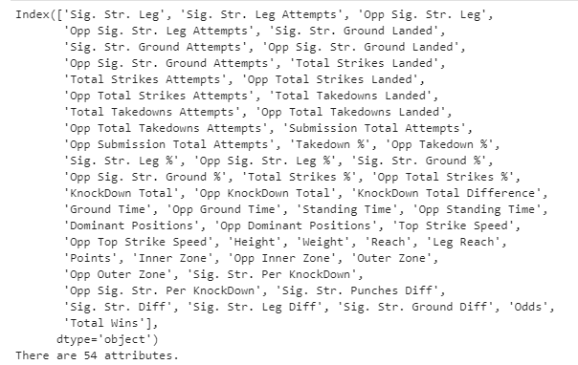
Observe
54 Attributes

Slide 7
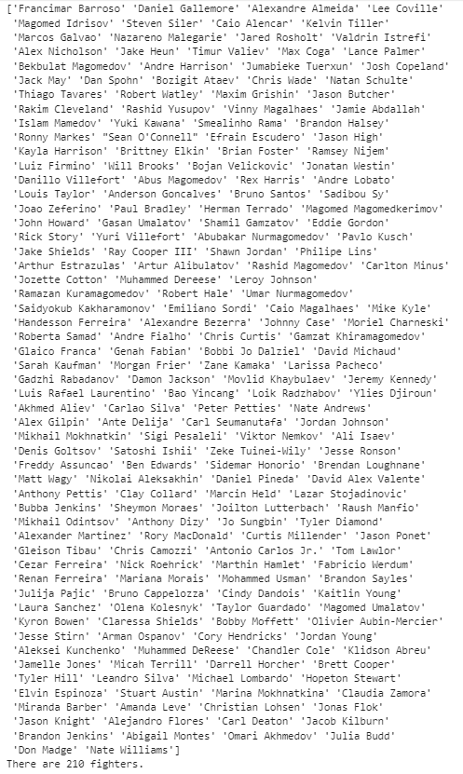
Observe
210 Fighters

Slide 8
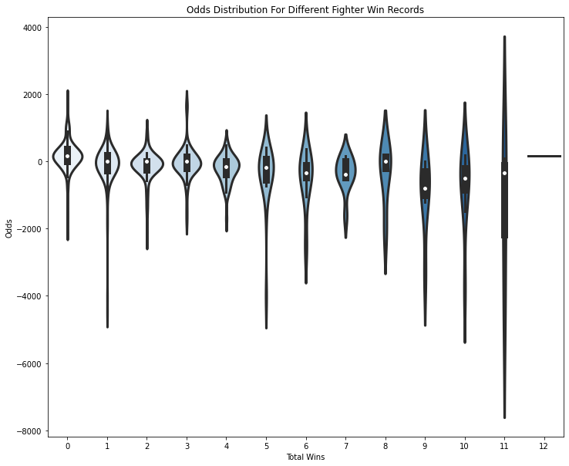
Analysis

Slide 9
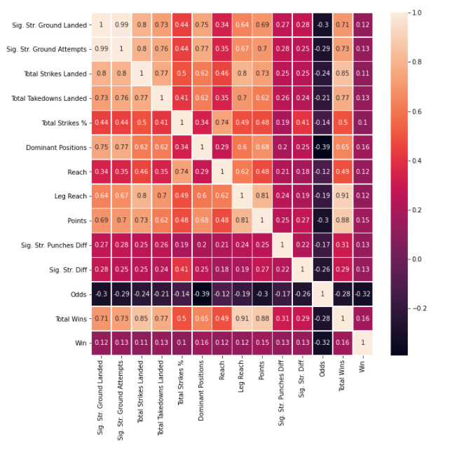
Analysis

Slide 10
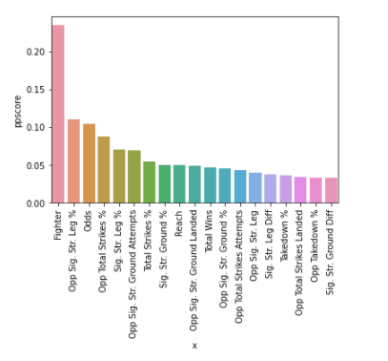
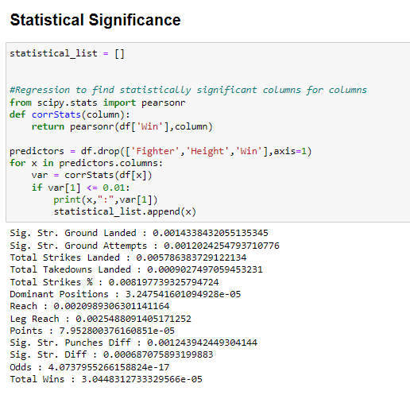
Analysis

Slide 11
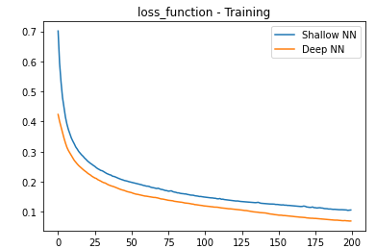
TensorFlow
TensorFlow is a type of deep learning neural network model
When using these types of models, we can either create a:
Shallow Neural Net - 1 hidden layer
Deep Neural Net - 2 or more hidden layers
The plot on the right depicts as the number of hidden layers increases the amount of loss decreases
As a result, I used a deep neural network model to make my predictions

Slide 12
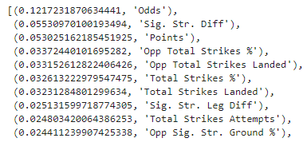
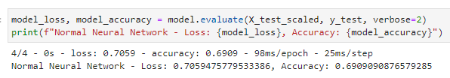
TensorFlow- Deep NN
Top 10 Features
I received an accuracy score of .69 using 52 features in my model. I chose to drop certain features such as total wins
I found that the predicted odds before each fight is the number 1 feature in the model. This means that whoever is creating these odds is doing a great job
Accuracy

Slide 13
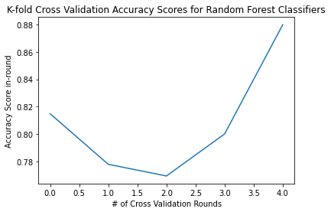
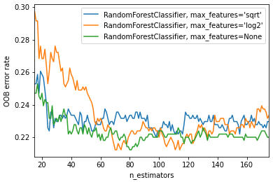
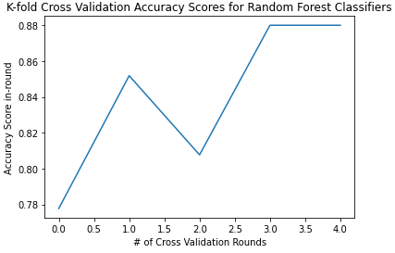
Random Forest
81%
The number of features in the dataset is large (54 features), which makes a good use case for decision tree modeling
Random Forests utilize an ensemble method (i.e., majority vote) combined with bootstrapping the dataset to build trees that predict class
5-fold cross validation testing resulted in average accuracy score of 84% for correctly predicting whether a fighter would win a fight based on fighting features
Model Tuning
84%

Slide 14
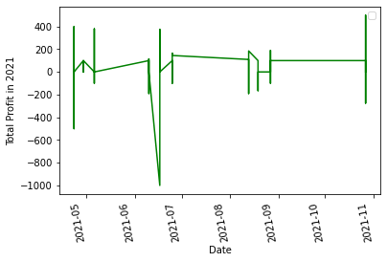
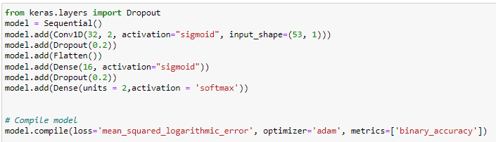
Keras - Convolutional Neural Network 1D
Profit in 2021 testing at $5,412
Accuracy is 80.61%

Slide 15
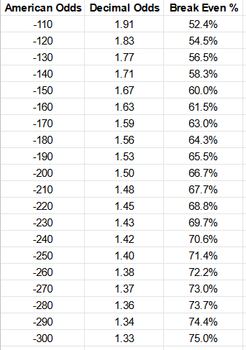
Perspective
84% Fight prediction success rate is high for sports
Typically, 55-60% is considered best in class for predicting game outcomes using purely sport data
This means the addition of the moneyline odds provides an "x-factor" that vastly improves our model
However, profitability is entirely dependent on the average odds from all bets wagered
Model accuracy rate must be higher than the breakeven success rate to consider this a profitable, valid betting strategy
The average odds for all fighters in the data set is –190 (1.52 decimal odds)
This gives a breakeven win rate of 65.75%
Our models outperform the sportsbooks by 18.25%

